Slide 1
Nuclear physics
Physics 2
Ing. Jaroslav Jíra, CSc.

Slide 2
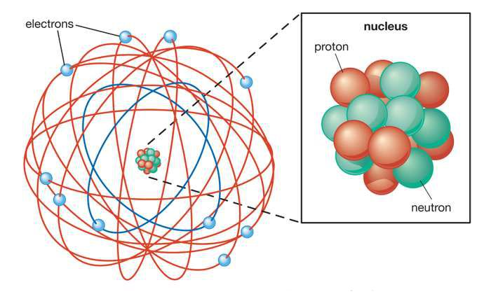
Nuclear terminology
Atomic nuclei are made up from protons and neutrons.
X … chemical symbol – chemical element
A … mass number (number of nucleons)
Z … atomic number (number of protons)
N … neutron number, mostly omitted
A = Z + N

Slide 3
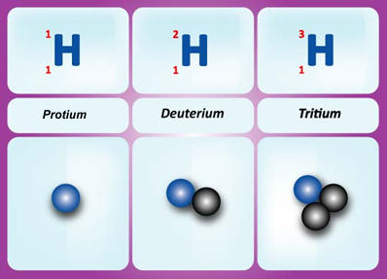
Nuclear terminology
Nuclide – a group of atoms of the same atomic number and mass number
Radionuclide – an unstable nuclide undergoing a transformation into a different nuclide, e.g. radioactive carbon ¹⁴₆C, which transforms into ¹⁴₇N. Stable carbon is ¹²₆C.
Isotopes – nuclides with the same atomic number and different mass number, e.g. ²³⁵₉₂U a ²³⁸₉₂U or
¹₁H (protium)
²₁H (deuterium)
³₁H (tritium),
Ion – electrically charged particle, atom or molecule, which has a lack or surplus of electrons compared to the number of protons, e.g. K⁺, H⁺, OH⁻

Slide 4
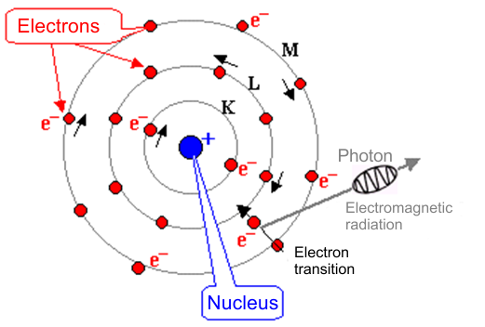
An Atom Structure
Diameter of an atom is approximalety 10⁻¹⁰ m.
Electrons are attracted to the nucleus by the Coulomb’s force which drops with increasing distance from the nucleus.
An atom can be excited by impact with some particle which results in transition of some electron to higher energy level. When the electron returns back to its original level (an atom returns to its ground state), the excessive energy is radiated as a photon (electromagnetic radiation).

Slide 5
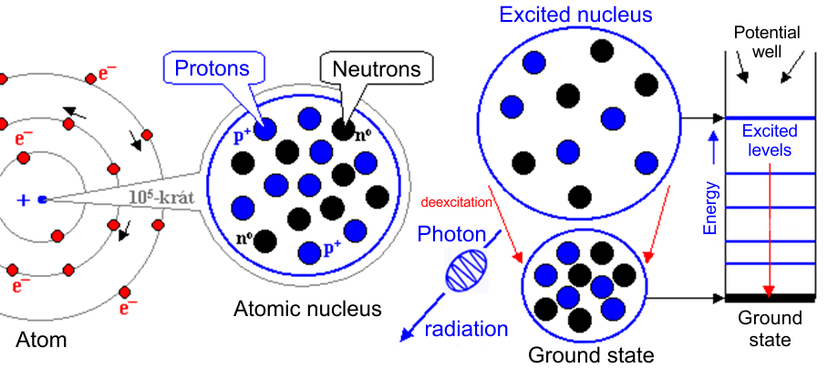
A Nucleus Structure
Size of a nucleus is approximalety 10⁻¹⁵ m (one fm – femtometer).
The nucleus is approximately 10⁵ times smaller than the atom
The nucleus can be also excited. Returning back to the ground state also results in electromagnetic radiation (mostly gamma rays)

Slide 6
Nuclear Dimensions and Masses
Diameter of the smallest nuclei: ≈ 10⁻¹⁵ m = 1 fm.
Diameter of larger nuclei:
where A is the mass number.
Nuclear mases are given in atomic mass units [u]. The atomic mass of the ¹²₆C is exactly 12u. The u can be calculated via Avogadro’s number.
atomic mass of any nuclide is then
Density of the nucleus:
The nucleus concentrates inside more than 99.95% of the total mass of the atom. The mass of electrons is only 1/2000 to 1/4000 of the total mass.

Slide 7
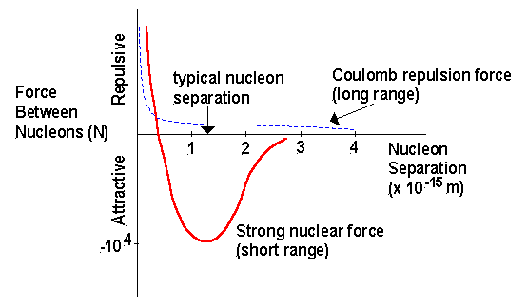
Nuclear Force
There are two main forces acting inside the atom nucleus. An electrostatic repulsive force between protons and also an attractive force called strong nuclear force. The nuclear force is stronger than the electrostatic one, so it can hold the nucleus together. On the other hand, the nuclear force has very limited range (around 3 fm). This fact puts an upper limit to the size of a nucleus to be still stable.
The protons in large nuclei are far enough apart that the repulsive force becomes important. The last stable isotope has an atomic number 82 (Pb).
The strong nuclear force has also saturation properties. If there are too many neutrons compared to the number of protons, the nucleus will not be stable.

Slide 8
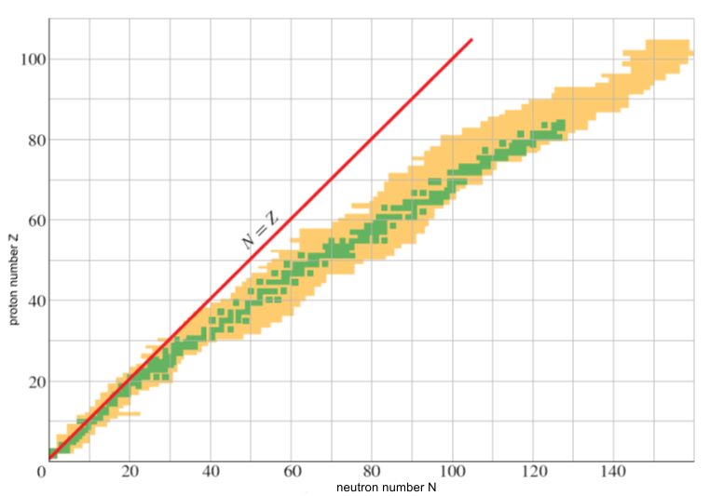
Stable and unstable isotopes
Stable isotopes are green, unstable (radioactive) are beige
Stability is deduced from the binding energy and size of the nucleus

Slide 9
Nuclear Binding Energy
As we already know, a nucleus consists of protons and neutrons, but the total mass of the nucleus is lower than the sum of proton and neutron masses m_{p} and m_{n}.
The mass defect is
This defect corresponds to the nuclear binding energy.
Example: we will determine the binding energy for a helium atom .
From tables we can find for the helium m_{nucleus}= 4.002604u
Proton and neutron masses are m_{p}= 1.007825u, m_{n}= 1.008665u.
An established practice is to recalculate this value per one nucleon, so the binding energy per nucleon in this case is

Slide 10
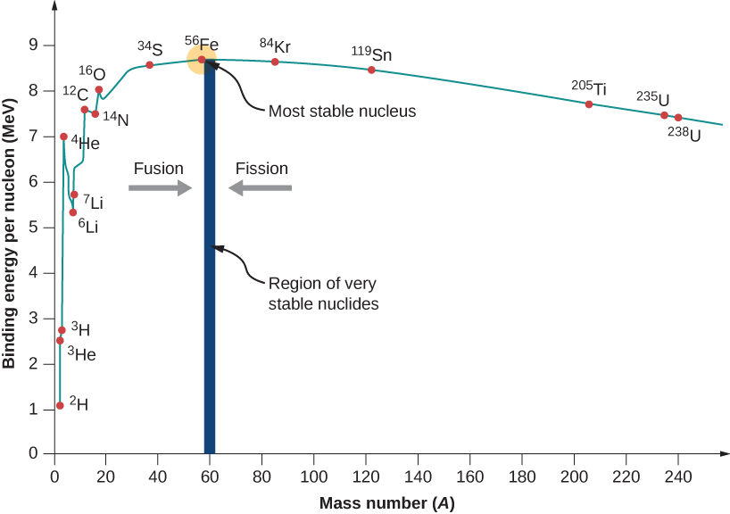
Nuclear Binding Energy
Binding energy can be also understood as an energy required to separate nucleus into its constituents.
The following graph shows the binding energy per nucleon as a dependence on the mass number. We can see that the binding energy drops for both low and high mass numbers and that there is stability area for A between 50 and 82.
The drop in the right part means that nucleons are more tightly bound in two middle mass nuclides rather than in a single high mass nuclide. This also means that the energy can be released by the nuclear fission of a single massive nucleus (nuclear power plant).
The drop in the left part means that an energy can be released if we combine two small mass nuclides to form a single middle mass number nuclide. This is called nuclear fusion (the sun, thermonuclear explosion).

Slide 11
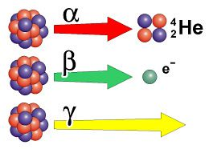
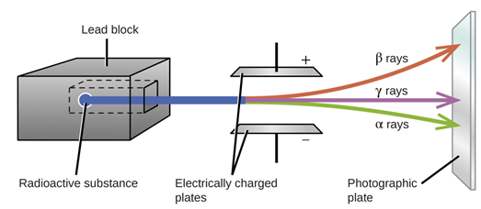
Natural radioactivity
Radioactivity (or radioactive decay) occurs when an unstable nucleus emits radiation. There are three types of nuclear radiation:
Alpha – consists of helium nuclei
Beta – consists of electrons
Gamma – consists of photons , electromagnetic radiation of wavelength λ<100 pm, frequency f> 3x10¹⁸ Hz (3 EHz)
The alpha radiation has a positive charge, so it is deviated downwards in the electric field on the picture, the beta radiation has a negative charge, so it is deviated upwards and the gamma has no charge, so its direction remains unchanged.

Slide 12
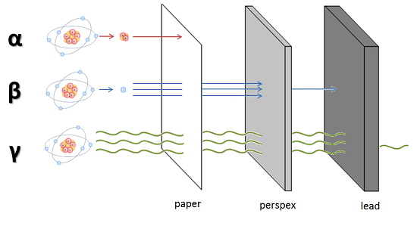
Natural radioactivity
Alpha particles – they are ejected from the nucleus with speed around 0.05 c. They are quickly absorbed after entering a matter. A sheet of paper can stop them.
Beta particles - they are ejected with speed around 0.9 c. They are more penetrable than alpha, they can partially pass through thin layer of metal or plastic.
Gamma particles – the most penetrating particles moving with speed of light, they can be stopped only by a thick layer of metal (lead is the best).

Slide 13
Radioactive Decay
Unstable radioactive nuclides undergo a process called radioactive decay. The nucleus spontaneously emits a particle and transforms itself into a different nuclide.
Suppose that a sample contains N radioactive nuclei at a time t. The number of nuclei (-dN) transformed during the time dt is proportional to the time dt, original number of nuclei N and the disintegration constant λ, which is characteristic for each material.
where N₀ is the number of nuclei at the time t=0 and N is the number of nuclei at the time t. After integration we obtain
The last formula is called exponential decay law.

Slide 14
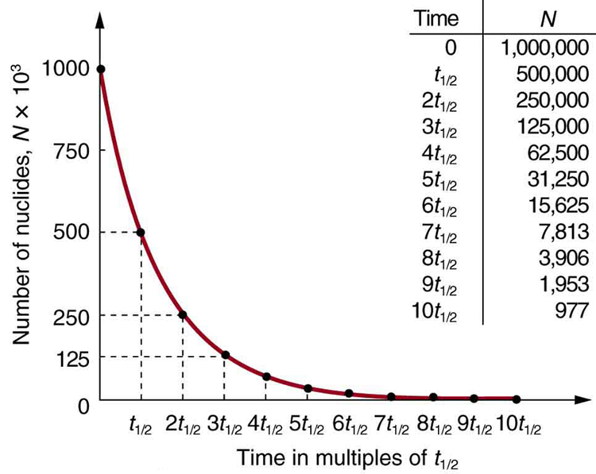
Radioactive Decay
A quantity of special interest is a half life τ defined as the time after which the number of radioactive nuclei is reduced to one half of the initial value.
Examples of several half lives:
0.3 μs
9.1 minutes
5.27 years
5730 years
4.5x10⁹ years

Slide 15
Radioactive Decay
Example: A radioactive isotope of mercury, ¹⁹⁷₈₀Hg, decays to gold, ¹⁹⁷₇₉Au, with a disintegration constant of 0.0108 h⁻¹.
(a) Calculate the half-life of the ¹⁹⁷Hg. What fraction of the sample will remain at the end of (b) three half-lives and (c) 10 days?.
a)
b)
c)

Slide 16
Radiation Dosage, Units
Since the radiation can be very dangerous for the human body it is important to know radiation units and what levels can be potentially harmful.
1) The activity R is defined as a number of disintegrations per second. The unit is Becquerel. 1Bq = 1 disintegration per second.
By differentiating the equation for the radioactive decay we obtain:
where is the activity at t=0.
2) The radiation absorbed dose D is defined as an energy absorbed per 1 kg of the absorbing material. The unit is Gray. 1Gy = 1 J/kg
An older unit used before was 1 rad = 0.01 Gy

Slide 17
Radiation Dosage, Units
3) The dose equivalent H also represents an energy absorbed per 1 kg of the material but it takes into account the type of radiation via Relative Biological Effectiveness factor (RBE). The unit is Sievert.
H = RBE · D or 1Sv = RBE · 1Gy [J/kg]
An older unit used before was 1 rem = 0.01 Sv
Radiation type | RBE factor
X rays, γ rays | 1
β particles | 1 - 1.7
slow neutrons | 4 – 5
fast neutrons | 10
α particles | 10 – 20

Slide 18
Radiation Doses and Their Effects
Dose equivalent [Sv] | Effect on human organism
< 0.25 | No immediate effect
1 | Radiation sickness, risk of cancer
5 | One half of those exposed die within 1 month
8 | Death within 2 weeks
10 – 50 | Death within 7 days
Type of exposure | Dose equivalent [mSv]
Annual exposure in the Czech Rep. | 3.2
Dental X ray | 0.005 - 0.1
Chest X ray | 0.02
Computer tomography | 2 - 16
Flight Tokyo - New York - Tokyo | 0.2
4th block of the Fukushima reactor | up to 400 mSv/h
Chernobyl, at the reactor | up to 300 Sv/h

Slide 19
Alpha, Beta and Gamma Decay
Alpha Decay
Unstable nucleus spontaneously emits alpha particle .
The mass of parent is greater than the mass of daughter plus α particle.
The kinetic energy is carried away by the α particle.
The reaction description An example
The half life for the uranium 238 is 4.5 billion years. Why does it take so long until the alpha particle is released out of the nucleus? The reason is that the nucleus is surrounded by very high potential barrier (around 30 MeV), while the energy of the alpha particle is only 4.25 MeV. The only mechanism the particle can get through is tunelling, which is statistically quantified by the transmission coefficient (probability that the particle gets through).
The particle hits the wall of the barrier 10²¹ times per second and after 10³⁸ attempts it finally gets through (in average).

Slide 20
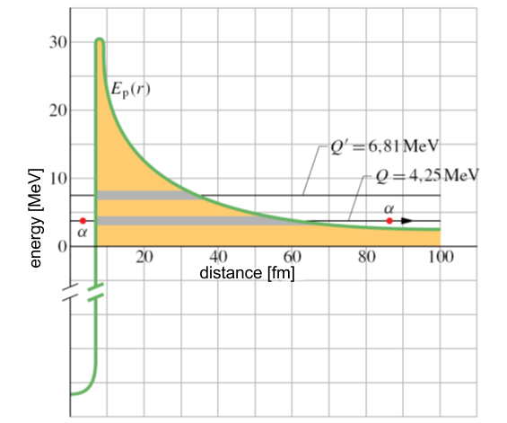
Tunelling
The transmission coefficient (probability to pass) is very sensitive to the energy of the particle. It can be demonstrated by the comparison between the ²³⁸U and ²²⁸U.
Q = 4.25 MeV for ²³⁸U, Q’ = 6.81 MeV for ²²⁸U,
Half lives
²³⁸U – 4,5x10⁹ years
²²⁸U – 9,1 minutes

Slide 21
Beta Decay
Unstable nucleus spontaneously emits an electron e⁻ or a positron e⁺ and neutrino ν or antineutrino $\overline{ν}$. This is caused by transformation of a proton into neutron or vice versa.
The kinetic energy is carried away by the electron/antineutrino or positron/neutrino pair.
Beta+ decay, proton into neutron
Beta- decay, neutron into proton
Neutrino and antineutrino are neutral particles of mass m < 1 eV/c². They have elusive character, they can pass through the Earth without any interaction. Their mean free path is several thousands light years.

Slide 22
Gamma Decay
After the alpha or beta decay, the nucleus may be left in an excited state.
When the nucleus undergoes deexcitation, it emits a high energy photon.
There is no change in charges or values of Z or A during the process.
Here are examples of the beta- decay accompanied by the gamma radiation. The cobalt 60 transforms into nickel 60 and iodine 131 transforms into xenon 131. The asterisk indicates an excited state.
Gamma energy: 1.3 MeV Half life: 5.27 years
Gamma energy: 364 keV Half life: 8 days years
These two radioisotopes are being used in radiotherapy – gamma knife, cyber knife, therapy of prosthate cancer etc.

Slide 23
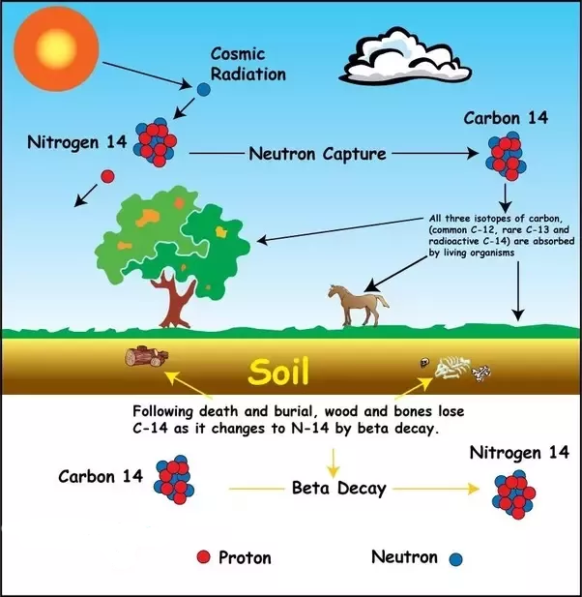
Radioactive Carbon Dating
Cosmic rays create ¹⁴C from ¹⁴N
There is constant ratio of the ¹⁴C/¹²C = 1.3x10⁻¹²
Living organisms have the same ratio.
When an organism dies, it no longer absorbs carbon.
The radioactive ¹⁴C then decays and the ratio ¹⁴C/¹²C changes.
The half life of ¹⁴C is 5730 years.
From the ratio ¹⁴C/¹²C we can estimate how old the organism is.

Slide 24
Nuclear Fission
Nuclear fission is a decay process in which an unstable nucleus splits into two fragments (the fission fragments) of comparable mass. There are also 2-3 fast neutrons as a side product of the decay plus released energy.
The most suitable isotopes for the nuclear fission are
A ²³⁵U absorbs a neutron
The resulting ²³⁶U* is excited and oscillates
Electric repulsion pushes two lobes apart
Two lobes separate forming fission fragments
2-3 neutrons are emitted at the time of fission
Here are equations of the two most frequent fisison processes

Slide 25
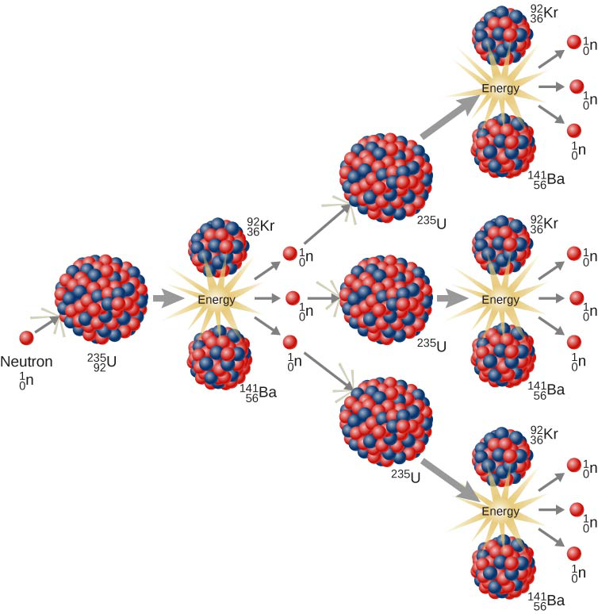
Nuclear Fission
The neutrons released by fission can cause a chain reaction.

Slide 26
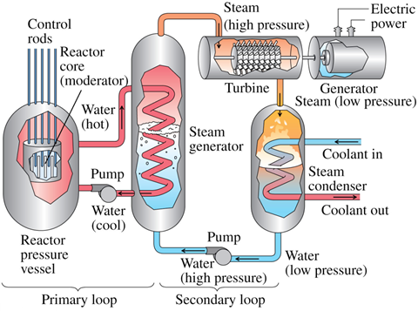
Nuclear Power Plant
A nuclear reactor can be used as a heat source for the nuclear power plant.
One fission releases energy around 200 MeV.
The fission of 1g of ²³⁵U or ²³⁹Pu liberates around 1 MW of power per day.
This is energy comparable to burning 3 tons of coal or 2000 liters of petrol.

Slide 27
Nuclear Fusion
In a nuclear fusion reaction, two or more light nuclei combine to form a larger nucleus. The process is hindered by the Coulomb repulsion (Coulomb barrier) preventing the parcticles to get close enough to each other.
To start the fusion we need first to give particles enough kinetic energy to overcome the Coulomb barrier. This can be achieved by very high temperature (10⁷ – 10⁸ K).
There are many combinations of possible nuclear fusions, here are some examples:

Slide 28
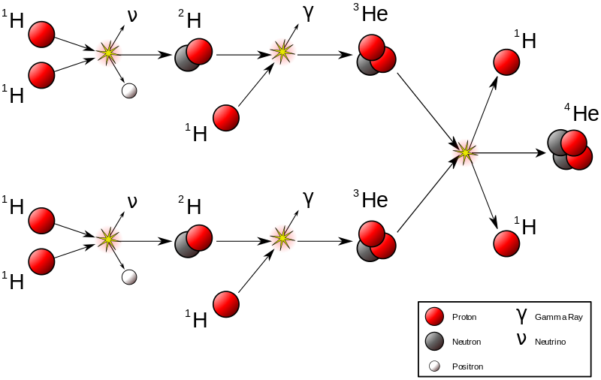
Nuclear Fusion
Nuclear fusion can be observed in stars. The temperature in the center of our sun is 15x10⁶ K and the typical series of reactions inside is so called proton-proton chain reaction where the hydrogen is being „burned“ to helium.
1. Two protons combine to form a deuteron as well as positron and neutrino
2. A proton combines with deuteron forming ³He and emitting a photon
3. Two ³He fuse, forming a 4He nucleus and two protons
The entire chain reaction releases 24.75 MeV of energy. Our sun contains enough fuel for billions years.

Slide 29
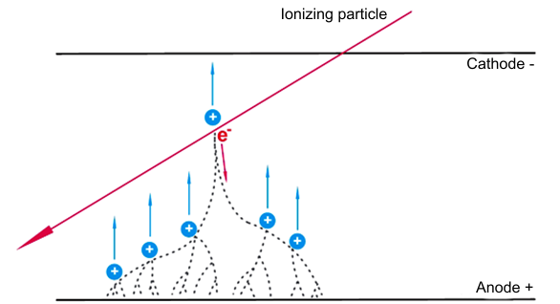
Detectors of Particles Geiger-Mueller counter
The Geiger-Mueller counter uses closed chamber filled with a noble gas (He, Ne) and strong electric field inside.
If a particle of sufficient energy gets into the chamber, it hits an atom of the gas and ionizes it. Due to the electric field the electron moves to the anode and positive ion moves towards the cathode. Both particles are also accelerated.
When such second generation electron hits another atom, it ionizes it as well and new electron-ion pair is generated. More and more electron-ion pairs are generated by this avalanche phenomenon until a current starts flowing between the cathode and anode due to the discharge.

Slide 30
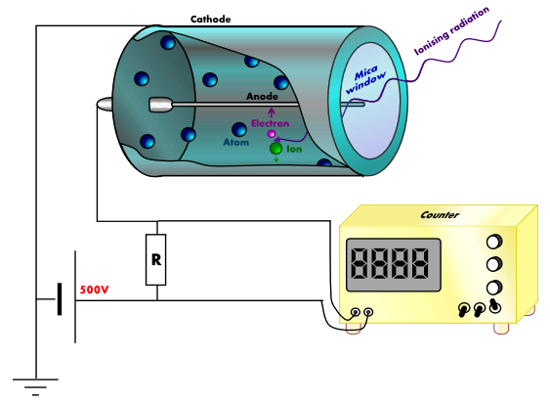
Geiger-Mueller counter
The basic part is a cylinder filled with a noble gas (He, Ne, Ar) and a quench gas (Br). Coating of the cylinder is a cathode and wire electrode is an anode.
The voltage between electrodes is 500 – 1000 V.
Ionizing radiation get inside through the window and ionizes the gas. Thanks to the discharge the anode is shortly connected to the cathode. The quench gas limits this time to approx. 5 ms.
The discharge generates a negative voltage impulse which can be further processed by electronics.

Slide 31
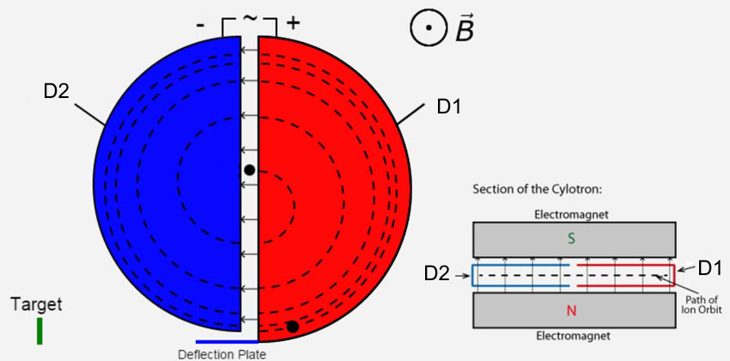
Particle Accelerators Cyclotron
Sometimes we need to generate high energy particles which cannot be obtained from natural sources of radioactivity.
One of posible solutions is a cyclotron. This device consists of two hollow D-shaped electrodes placed in vacuum with magnetic field applied perpendicularly to the electrodes.
The electrodes are powered by an AC voltage source of amplitude 10⁴-10⁵ V. When the particle is between electrodes it is accelerated by the electric field towards one of electrodes (to +D1 for the electron). Inside the electrode there is only magnetic field acting, which causes circular motion of the particle.
When the particle leaves the D1, the polarity of applied voltage must be reversed so that the particle would be attracted to the D2.

Slide 32
Cyclotron
The polarity must be reversed each time before a particle leaves an electrode and appears in the gap. The electric field accelerates the particle in the gap and magnetic field turns its direction inside the D electrode backwards. The particle moves in a spiral and its velocity gradually raises. When the particle reaches the maximum velocity (at the perimeter), it is released out of the cyclotron towards the target.
Since the magnitude of velocity is constant inside the D electrode (magnetic field only changes the direction, not magnitude), we can deduce a formula for the frequency of the AC voltage from the balance between centrifugal and Lorentz forces.
The last formula determines a cyclotron frequency, which is independent on the radius r.

Slide 33
Example: A cyclotron accelerates deuterons of mass m=3.3x10⁻²⁷ kg. The potential difference between D electrodes is U= 50 kV, the magnetic field B= 1.5 T and the particle leaves the cyclotron with energy E_{max}= 16 MeV.
Determine: a) the cyclotron frequency, b) how many times the particle passes through the gap between electrodes, c) radius of the cyclotron
a)
b) We suppose zero initial energy of the particle. Each pass through the gap means gain of energy
The particle achieves E_{max} after n passes through the gap.
c)

