Slide 1
Lasers
Physics 2
Ing. Jaroslav Jíra, CSc.

Slide 2
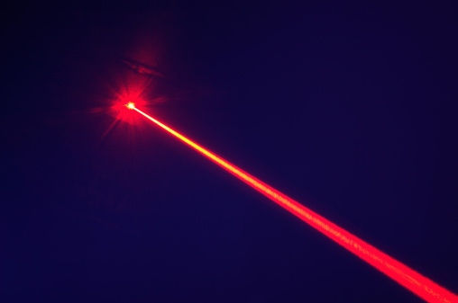
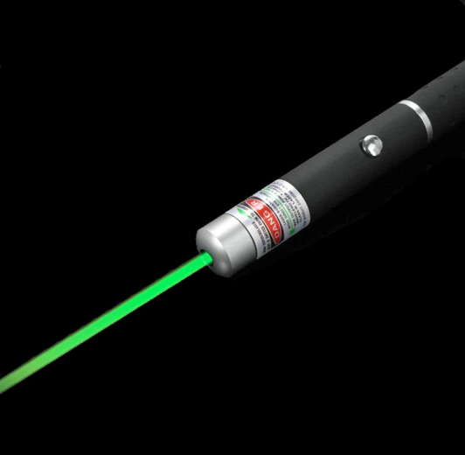
Lasers – the Bacis Terms
The word LASER is an acronym for the term Light Amplification by Stimulated Emission of Radiation.
As we can estimate from the name, the key to the laser operation is stimulated emission. Let us assume isolated atom that can exist only in two states – the ground state of energy E₀ and excited state of energy E_{x}. There are three processes by which the atom can move from one state to another:
Absorption
Spontaneous emission
Stimulated emission

Slide 3
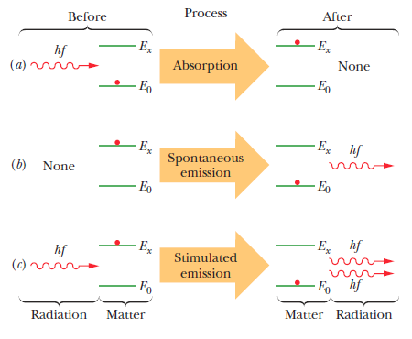
Stimulated Emission
a) Absorption. The atom is initially in its ground state E₀. If it is hit by a photon of energy hf= E_{x}-E₀, the atom absorbs the photon and goes to the state E_{x}.
b) Spontaneous emission. The atom is in excited state E_{x}. After a time it spontaneously moves to its ground state and emits a photon of energy hf.
c) Stimulated emission. The atom is in excited state E_{x}. A photon of energy hf can stimulate the atom to move to its ground state, during which process the atom emits an additional photon of the same parameters, whose energy is also hf. We call this process stimulated emission.

Slide 4
Stimulated Emission – Inversion Population
If we have an atom in the thermal equilibrium state with N₀ atoms in the ground state E₀ and N_{x} atoms in the excited state E_{x}, the ratio between these two numbers can be expressed by the Boltzmann’s distribution:
Where k is Boltzmann’s constant and T is temperature. Since the E_{x} is greater than E₀, the number N_{x} will be always lower than N₀.
If we flood such atoms with photons of energy E_{x} - E₀, photons will disappear via absorption by ground-state atoms and photons will be generated largely via stimulated emission of excited-state atoms. Einstein showed that the probabilities per atom for these two processes are identical. Thus, because there are more atoms in the ground state, the net effect will be the absorption of photons.
For generating the laser light we need more photons emitted than absorbed. We need more atoms in the excited state than those in the ground state. This is called population inversion.

Slide 5
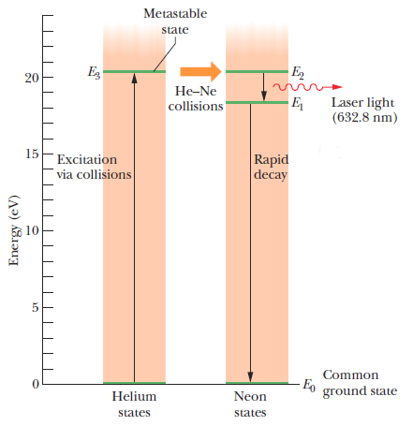
Helium-Neon Gas Laser
One of examples how to achieve inverted population is helium-neon laser, where the excitation is achieved by electrical pumping.
The basic part of the laser is a glass tube filled with 80:20 mixture of helium and neon (pressure 10-100 Pa). An electric current passes through the gas and colliding electrons raise many He atoms to the excited state E₃. This state is metastable (life around 1 μs).
The energy of helium state E₃ (20.61 eV) is very close to the energy of neon state E₂ (20.66 eV). Thus, when a metastable (E₃) He atom and a ground state (E₀) Ne atom collide, the excitation energy of the He atom is often transferred to the Ne atom, which then moves to state E₂. In this manner, Ne level E₂ (with a mean life of 170 ns) can become more heavily populated than Ne level E₁ (with a mean life of 10 ns is almost empty).

Slide 6
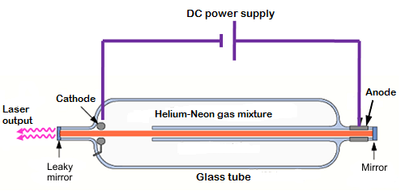
Helium-Neon Gas Laser
Here is the construction of He-Ne laser. After turning on, the DC power supply must give a voltage ignition pulse (10 kV). At the moment of beginning breakdown, the electrical resistance of the tube suddenly falls to a low value. From this moment, only sustaining voltage (1 kV) is enough to maintain the stimulated emission.
There are two mirrors placed on both ends of the tube, one of them is leaky to allow some part of the light to produce laser beam.
The stimulated emission photons move in various directions but most of them are stopped at tube walls.
Resonance cavity
The photons moving parallel to the tube axis are still moving to and fro due to reflections from mirrors. A chain reaction builds up rapidly in this direction accounting for the inherent parallelism of the laser light.
Since the excited levels on the neon are E₂=20.66 eV and E₁=18.7 eV, the photon wavelength corresponding to the E₂ ->E₁ transition is 632.8 nm, so the color of the laser beam is red.

Slide 7
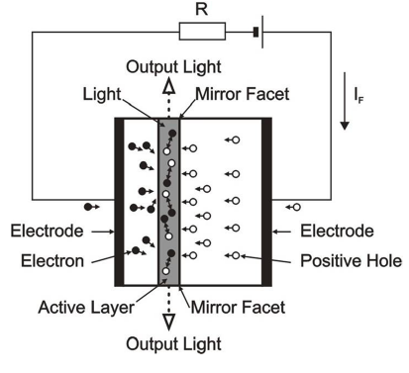
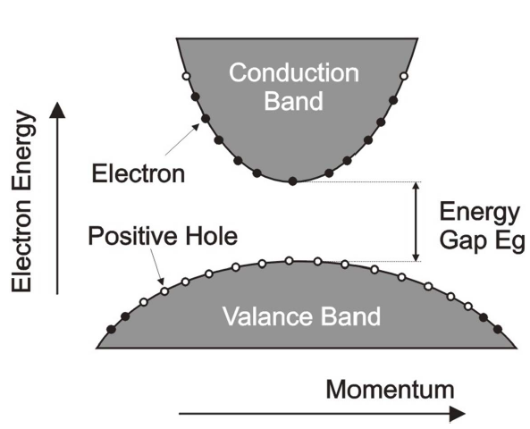
Semiconductor Laser
The principle of laser diode is also based on stimulated emission. The diode consists of PN junction flown through with electric current. The higher energy state is electron in the conduction band and lower energy state is a hole in the valence band.
Electrons are pumped to the P layer by the electric field and holes remain in the N. When the electron recombines with the hole in the N layer, a photon is emitted. Its wavelength is given by the bandgap width. The most common material of layers is AlGaAs and dopants.
N
P

Slide 8
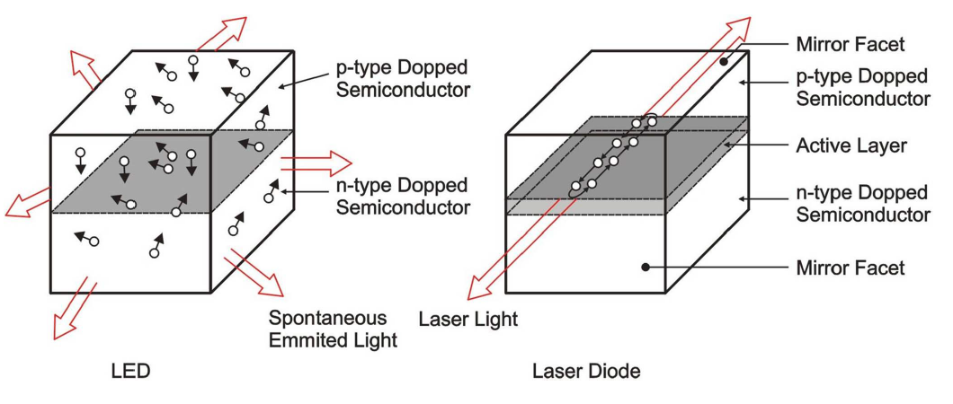
LED Diode and Laser Diode
The principle of light generating is similar in both diodes, but while the light from the LED diode is multidirectional, the direction of laser diode light is unidirectional and given by two mirrors, like in case of the He-Ne laser.
Laser diode is much cheaper and easier to produce than the He-Ne laser but there are some disadvantages:
The bandwidth of the laser diode is around 15 nm (compared to 0.002 nm for He-Ne). Also the divergence is greater in case of laser diode, and its beam must be focused by a lens.

Slide 9
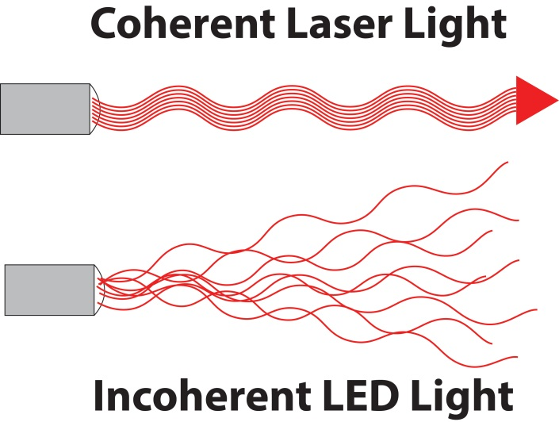
Properties of the Laser Light
1. Laser light is highly monochromatic. The laser light has very high spectral purity. Helium-neon laser of wavelength 632.8 nm has the bandwidth of 0.002 nm, for example.
2. Laser light is highly coherent. The waves of the laser light are in phase in space and time.
3. Laser light is highly directional. Typical divergence is around 1 mrad, which means a spot of 10 cm in diameter 100 meters from the laser.
4. Laser light can be sharply focused. We can achieve an intensity up to 10¹⁷ W/cm² with the laser. An oxyacetylene flame, by contrast, has an intensity of only about 10³ W/cm².

